Slide 1



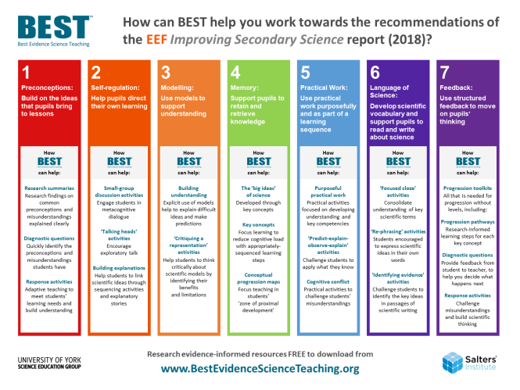





&
@BestEvSciTeach
www.BestEvidenceScienceTeaching.org
Notes:
Best Evidence Science Teaching (BEST) is a large, online collection of FREE research-informed resources to support science teaching in secondary schools (age 11-16).
This presentation explores how some of the resources provided by the Best Evidence Science Teaching project could help teachers to work towards the recommendations of the EEF Improving Secondary Science guidance report by developing research evidence-based practices in school.
The BEST resources are developed by the University of York Science Education Group with generous support from the Salters' Institute, and are hosted online by STEM Learning at:
www.BestEvidenceScienceTeaching.org

Slide 2

What’s
?

Slide 3
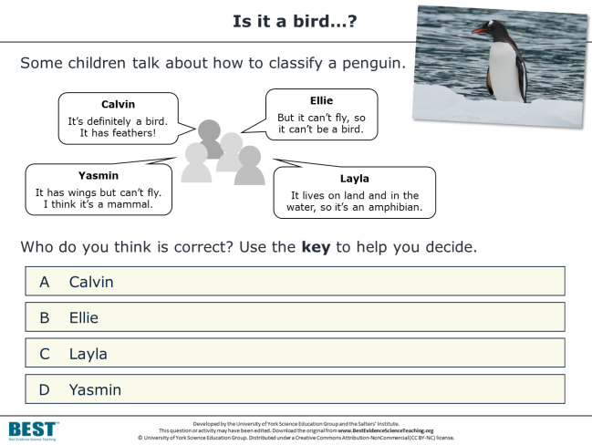
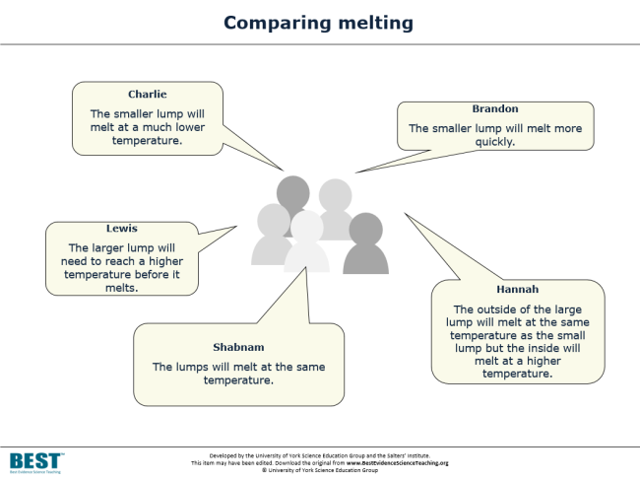
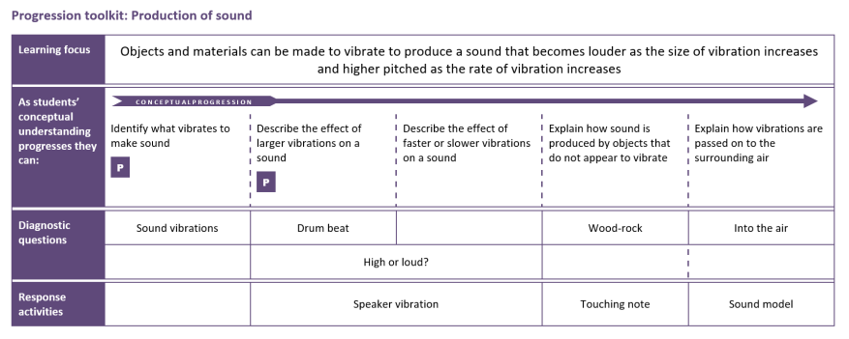
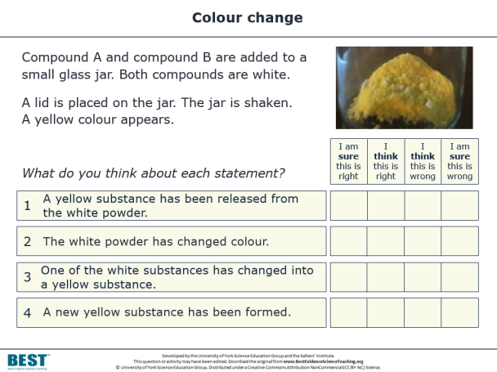
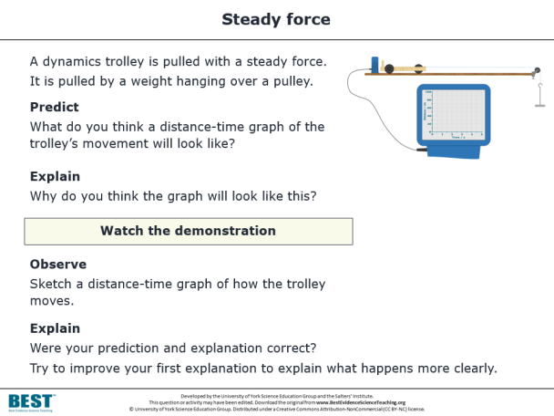
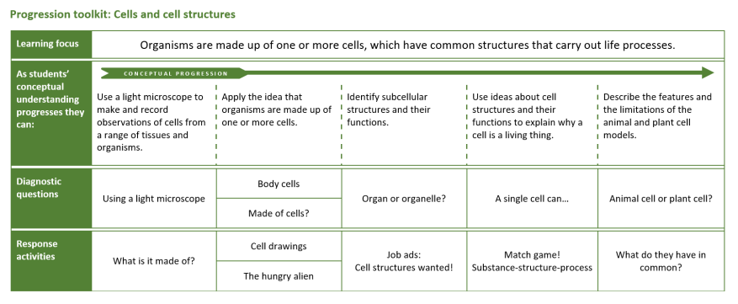
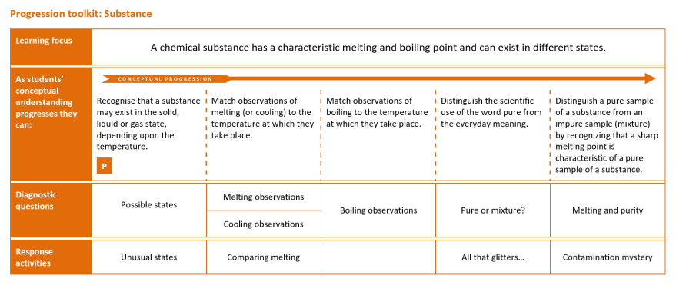
Hundreds
of
resources
All based
on research evidence
ONLINE, OPEN-ACCESS & FREE!
DIAGNOSTIC QUESTIONS
RESPONSE ACTIVITIES
PROGRESSION TOOLKITS
…to help teachers develop evidence-based practices
…to test and consolidate students’ understanding of key concepts in science.
Notes:
In a nutshell, the Best Evidence Science Teaching project provides a large collection of resources for science teachers, all developed from research evidence and all online, open access and completely FREE to use.
There is a vast body of published research into school students’ understanding of science, their preconceptions and common misunderstandings. We’re surveying that research literature systematically for key concepts taught in secondary school science, and turning it into a series of diagnostic questions – short, formative assessment items that teachers can use quickly and easily in lessons to collect evidence of what their students understand and – crucially – what preconceptions and misunderstandings they have.
Often the research will describe ways in which teachers could respond to and challenge these misunderstandings – for example through particular interventions and constructivist approaches that aim to move students’ thinking on towards the kind of scientific understanding we would wish them to have. We’ve used this research to develop response activities, paired up with the diagnostic questions.
And we’ve gone a little further than that. There’s a lot of research into learning progression and effective sequencing of ideas to help build understanding. So we’ve used that to develop a progression toolkit for each key concept, which sets out appropriate learning steps to help move students’ thinking on.
Our aim is to transform research evidence into practice, to help science teachers develop their evidence-based practices in the classroom. Ultimately we hope this will help teachers to help students develop better understanding of key concepts in science.

Slide 4

and
Improving Secondary Science

Slide 5
The Education Endowment Foundation (EEF) published a guidance report in 2018 titled ‘Improving Secondary Science’
The report cites Best Evidence Science Teaching as a good source of:
  diagnostic questions
  activities that promote metacognitive talk and dialogue
The report makes seven main recommendations…
Notes:
As we were developing Best Evidence Science Teaching, the UK’s Education Endowment Foundation (EEF) was developing its Improving Secondary Science guidance report, published in 2018.
The report cites Best Evidence Science Teaching as a good source of diagnostic questions and a good source of activities that promote metacognitive talk and dialogue.

Slide 6

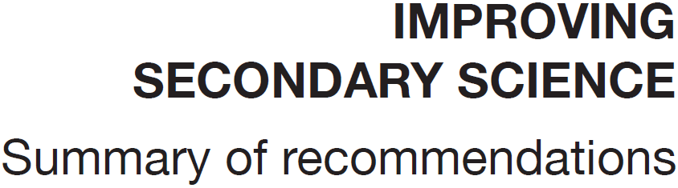
1
Preconceptions
Build on the ideas that pupils bring to lessons
2
Self-regulation
Help pupils direct their own learning
3
Modelling
Use models to support understanding
4
Memory
Support pupils to retain and retrieve knowledge
5
Practical work
Use practical work purposefully as part of a learning sequence
6
Language of science
Develop scientific vocabulary
7
Feedback
Use structured feedback to move on pupils’ thinking
Notes:
The EEF report makes seven main recommendations…
Or, to put it another way, the report identified seven main areas in which the development of evidence-based approaches could help to improve the teaching and learning of secondary science. So these seven areas provide a framework that could help to focus efforts in developing evidence-based approaches in school.

Slide 7




How can BEST help you work towards the recommendations of the EEF Improving Secondary Science report (2018)?
1
Preconceptions:
Build on the ideas that pupils bring to lessons
2
Self-regulation:
Help pupils direct their own learning
3
Modelling:
Use models to support understanding
4
Memory:
Support pupils to retain and retrieve knowledge
5
Practical Work:
Use practical work purposefully and as part of a learning sequence
6
Language of Science:
Develop scientific vocabulary and support pupils to read and write about science
7
Feedback:
Use structured feedback to move on pupils’ thinking
Research summaries
Research findings on common preconceptions and misunderstandings explained clearly
Diagnostic questions
Quickly identify the preconceptions and misunderstandings students have
Response activities
Adaptive teaching to meet students’ learning needs and build understanding
Small-group
discussion activities
Engage students in metacognitive
dialogue
‘Talking heads‘ activities
Encourage
exploratory talk
Building explanations
Help students to link scientific ideas through sequencing activities and explanatory stories
Building
understanding
Explicit use of models help to explain difficult ideas and make predictions
‘Critiquing a representation’ activities
Help students to think critically about scientific models by identifying their benefits
and limitations
The ‘big ideas’
of science
Developed through
key concepts
Key concepts
Focus learning to reduce cognitive load with appropriately-sequenced learning steps
Conceptual progression maps
Focus teaching in students’ ‘zone of proximal development’
Purposeful
practical work
Practical activities focused on developing understanding and
key competencies
‘Predict-explain- observe-explain’ activities
Challenge students to apply what they know
Cognitive conflict
Practical activities to challenge students’ misunderstandings
‘Focused cloze’ activities
Consolidate understanding of key scientific terms
‘Re-phrasing’ activities
Students encouraged to express scientific ideas in their own words
‘Identifying evidence’ activities
Challenge students to identify the key ideas in passages of scientific writing
Progression toolkits
All that is needed for progression without levels, including:
Progression pathways
Research-Informed learning steps for each key concept
Diagnostic questions
Provide feedback from student to teacher, to help you decide what happens next
Response activities
Challenge misunderstandings and build scientific thinking
How
can help:
How
can help:
How
can help:
How
can help:
How
can help:
How
can help:
How
can help:
Research evidence-informed resources FREE to download from
www.BestEvidenceScienceTeaching.org
Notes:
We’ve produced this poster that suggests how the Best Evidence Science Teaching resources can help teachers to develop research evidence-informed approaches in the seven main areas identified in the EEF report.
We would never claim that Best Evidence Science Teaching is a quick fix to meeting the EEF’s recommendations, or to developing evidence-based practises in classrooms, but we do think the research-informed resources we’ve developed can be a useful tool for teachers in working towards this.

Slide 8
examples

Slide 9

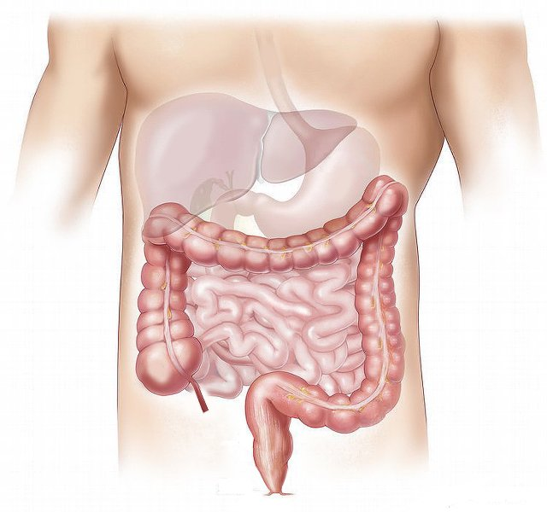
Moving through the digestive system
Simple
multiple
choice
Food we swallow moves through the digestive system.
What is the main thing that causes food to move through the digestive system?
A
Gravity
B
Contraction of muscles in the digestive system
C
Vibrations from body movements such as walking
D
Swallowing more food pushes it along
Notes:
This is one example of a diagnostic question, taken from the hundreds of resources published as part of the Best Evidence Science Teaching collection. It’s aimed at lower secondary school students (age 11-14). It assesses understanding of the key concept that muscles are an essential part of organ systems.
The best answer is B – contracting muscles (a.k.a. peristalsis) is what is principally responsible for moving food through the digestive system. The other options, or ‘distracters’ as well call them, are misunderstandings that have been reported in the research literature as being common misunderstandings in children of lower secondary age.

Slide 10
Moving through the digestive system
1
Preconceptions
Build on the ideas that pupils bring to lessons
Food we swallow moves through the digestive system.
What is the main thing that causes food to move through the digestive system?
7
Feedback
Use structured feedback to move on pupils’ thinking
A
Gravity
B
Contraction of muscles in the digestive system
4
Memory
Support pupils to retain and retrieve knowledge
C
Vibrations from body movements such as walking
D
Swallowing more food pushes it along
Notes:
Thinking about this with respect to the recommendations of the EEF Improving Secondary Science report, the diagnostic question provides evidence of preconceptions that students might have (recommendation #1).
The key phrase in EEF recommendation #1 is “Build on…”. When students answer this diagnostic question, it provides feedback from student to teacher about what they’re thinking, and the teacher can then provide feedback to the students about what they’ve misunderstood (recommendation #7).
The question could be used as the basis for some teacher-led dialogic questioning, e.g. why did students pick the answers they did? What do they think are the relative contributions of these factors in moving food through the digestive system? What would their answer be if the question was asked about a person who was lying down, or was motionless because they are asleep, or was an astronaut in space?
Alternatively, students could talk in small groups about what they think are the right and wrong answers – and why. This type of metacognitive dialogue can help to move students’ thinking on from their preconceptions towards the scientific understanding we would want them to have – and in doing so, help them to retain and retrieve the knowledge needed to understand key concepts (recommendation #4).

Slide 11
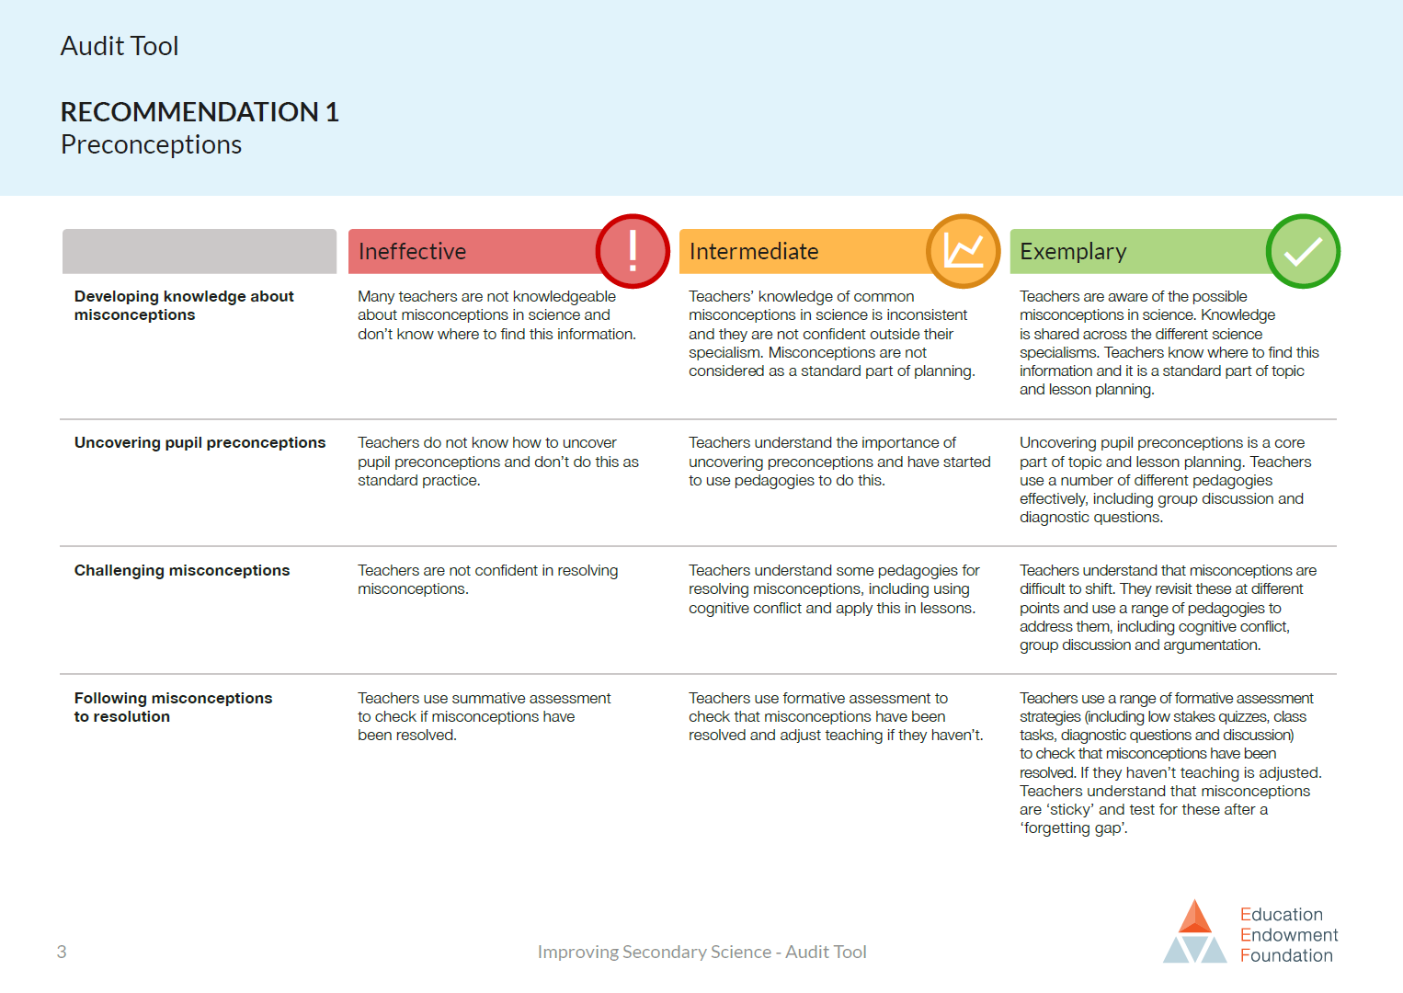
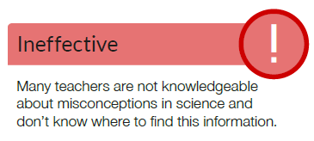
Notes:
The EEF published an ‘audit tool’ to accompany their report, in which they have set out short descriptors of what they think are ineffective, intermediate and exemplary practice in each of the seven areas. This is one page from the audit tool, and it relates to the first area – Preconceptions.
The first row is about teachers’ knowledge of common misconceptions.

Slide 12
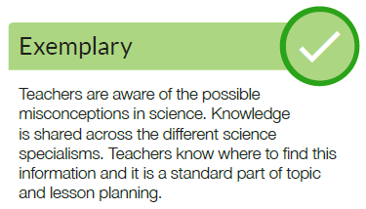
Notes:
It’s easy to see how the resources we’ve developed for Best Evidence Science Teaching could help a teacher to start moving from left to right along those descriptors.

Slide 13
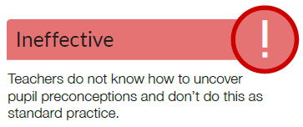
Notes:
The second and third rows are about teachers uncovering and resolving misconceptions in their students’ thinking.

Slide 14
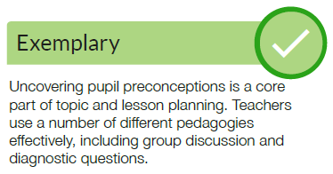
Notes:
Again, it’s easy to see how the resources we’ve developed for Best Evidence Science Teaching could help a teacher to start moving from left to right along those descriptors.

Slide 15

Respiration and breathing
Focused
cloze
Respiration is one of the processes carried out by living things.
Complete the sentences in the box.
You should only use respiration or breathing to fill each gap.
Moving air into and out of your lungs is called ………………………… .
Using food as fuel to provide energy is called ………………………… .
………………………… happens in all living things.
………………………… only happens in some living things.
………………………… does not happen in plants.
………………………… provides living things with oxygen for ………………………… .
Notes:
This is another example of a diagnostic question from the Best Evidence Science Teaching collection.
This on is a particular type of ‘fill the gaps’ (cloze) activity, in which there are only two words from which the student can choose to fill the gaps. We call this a focussed cloze. The words provided to fill the gaps are a pair of words for which there is research evidence that they are commonly confused by students. Because there are lots of gaps but only two words, students really need to understand the difference between the two words to fill all the gaps correctly.

Slide 16
Respiration and breathing
6
Language of science
Develop scientific vocabulary
Focused
cloze
Respiration is one of the processes carried out by living things.
Complete the sentences in the box.
You should only use respiration or breathing to fill each gap.
1
Preconceptions
Build on the ideas that pupils bring to lessons
Moving air into and out of your lungs is called ………………………… .
Using food as fuel to provide energy is called ………………………… .
………………………… happens in all living things.
………………………… only happens in some living things.
………………………… does not happen in plants.
………………………… provides living things with oxygen for ………………………… .
7
Feedback
Use structured feedback to move on pupils’ thinking
4
Memory
Support pupils to retain and retrieve knowledge
Notes:
Thinking about this with respect to the recommendations of the EEF Improving Secondary Science report, a focussed cloze activity helps to probe and develop students’ understanding of scientific vocabulary (recommendation #6) by encouraging them to think about using words in a scientific (rather than everyday) way.
It also provides evidence of students’ preconceptions and misunderstanding (recommendation #1), and helps you to build upon these through feedback (recommendation #7) to encourage development of the kind of scientific understanding we want students to have – so that they can retain and retrieve understanding of key concepts (recommendation #4).

Slide 17
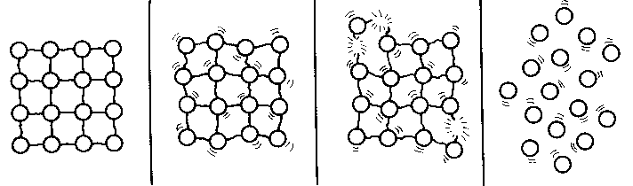
Particle model - melting
Critiquing a model
The diagram is from a textbook.
It shows the particle model of a substance in the solid state melting so that the sample is in the liquid state.
To talk about in your group
State three ways in which you think the diagram is a good representation of a substance melting.
State three ways in which you think the diagram is not an accurate representation of a substance melting.
Notes:
This is an example of a response activity from the Best Evidence Science Teaching collection. It’s a small group discussion activity, designed to facilitate metacognitive talk and dialogue. In this kind of discussion, students have to think critically about what they know and understand, and discussion encourages ‘meaning making’ through social construction of understanding.
This discussion activity is focussed on critiquing a scientific model. This is a way of making scientific models explicit, and to get students to think critically about the uses and limitations of models.
The model is presented in this kind of activity without any indication of whether it’s a good or bad model; students have to talk about what the parts of the model represent, the uses and limitations of the model, and decide for themselves how useful it is.

Slide 18
Particle model - melting
3
Modelling
Use models to support understanding
2
Self-regulation
Help pupils direct their own learning
Critiquing a representation
The diagram is from a textbook.
It shows the particle model of a substance in the solid state melting so that the sample is in the liquid state.
1
Preconceptions
Build on the ideas that pupils bring to lessons
7
Feedback
Use structured feedback to move on pupils’ thinking
To talk about in your group
State three ways in which you think the diagram is a good representation of a substance melting.
State three ways in which you think the diagram is not an accurate representation of a substance melting.
4
Memory
Support pupils to retain and retrieve knowledge
Notes:
With respect to the recommendations of the EEF Improving Secondary Science report, the metacognitive talk and dialogue that takes place in a small group discussion activity enables students to direct their own learning (recommendation #2). This helps to build upon students’ preconceptions (recommendation #1) through feedback from peers and the teacher (recommendation #7) to encourage development of the kind of scientific understanding we want students to have – so that they can retain and retrieve understanding of key concepts (recommendation #4).
In this particular case it also encourages students to think explicitly and critically about the use of models in science (recommendation #3).

Slide 19
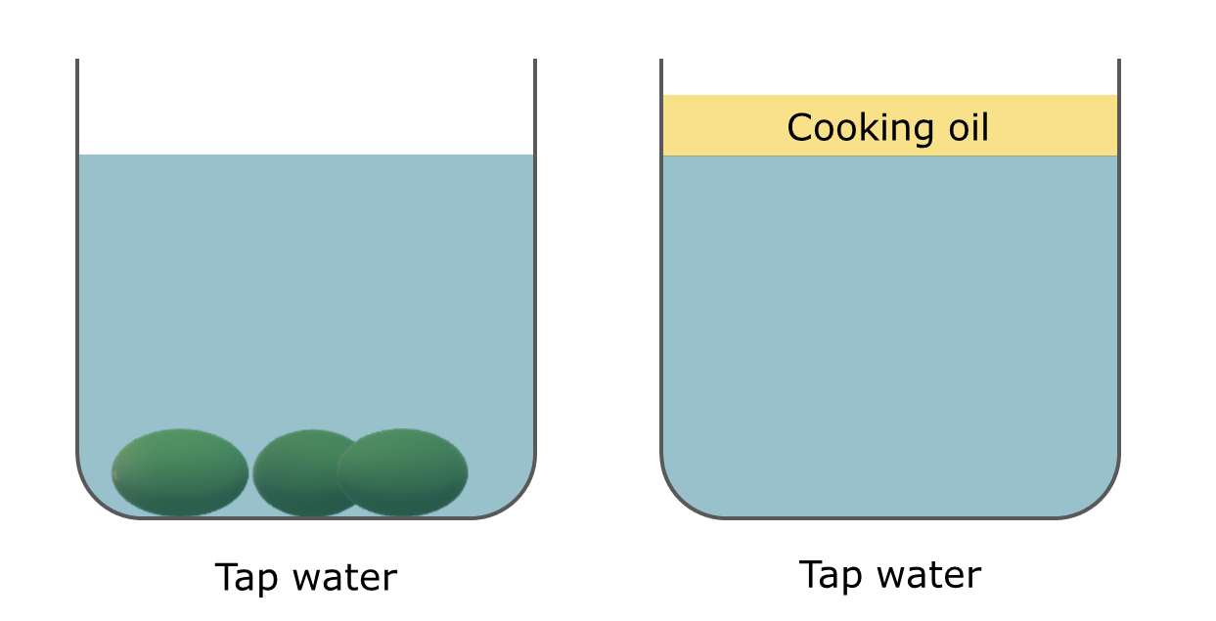
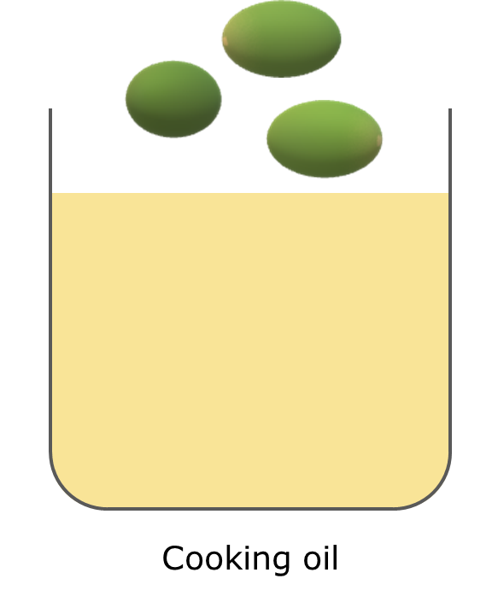
Grape expectations
PEOE
Grapes sink in tap water.
Cooking oil floats on tap water.
Predict
What will happen when grapes are put into cooking oil?
Explain
Explain why you think this will happen.
Watch the demonstration
Observe
Describe what you see.
?
Explain
Were your prediction and explanation correct?
Try to improve your first explanation to explain what happens more clearly.
Notes:
This is another example of a response activity from the Best Evidence Science Teaching collection.
This activity facilitates purposeful practical work, in the form of a predict-explain-observe-explain (PEOE) activity. This allows students to apply what they know to make a prediction, challenges their thinking about a phenomenon, and encourages them to build explanations for what they have predicted and what they observe.
The practical work can be very simple, but is powerful because it is used purposefully to develop students’ scientific understanding as part of a learning progression (in this case, a learning progression on density and buoyancy).

Slide 20
Grape expectations
5
Practical work
Use practical work purposefully as part of a learning sequence
PEOE
Grapes sink in tap water.
Cooking oil floats on tap water.
Predict
What will happen when grapes are put into cooking oil?
2
Self-regulation
Help pupils direct their own learning
Explain
Explain why you think this will happen.
1
Preconceptions
Build on the ideas that pupils bring to lessons
Watch the demonstration
Observe
Describe what you see.
?
Explain
Were your prediction and explanation correct?
Try to improve your first explanation to explain what happens more clearly.
4
Memory
Support pupils to retain and retrieve knowledge
Notes:
With respect to the recommendations of the EEF Improving Secondary Science report, the metacognitive talk and dialogue that takes place when students think about how to explain their prediction, and how to explain what they then observe in the practical activity, enables students to direct their own learning (recommendation #2). This helps to build upon students’ preconceptions (recommendation #1) to encourage development of the kind of scientific understanding we want students to have – so that they can retain and retrieve understanding of key concepts (recommendation #4).
This kind of practical PEOE activity is purposeful because it is tightly focussed on a key concept (buoyancy in this case) and is used to develop students’ scientific understanding as part of a learning progression (on density and buoyancy) (recommendation #5).

Slide 21
impact?

Slide 22
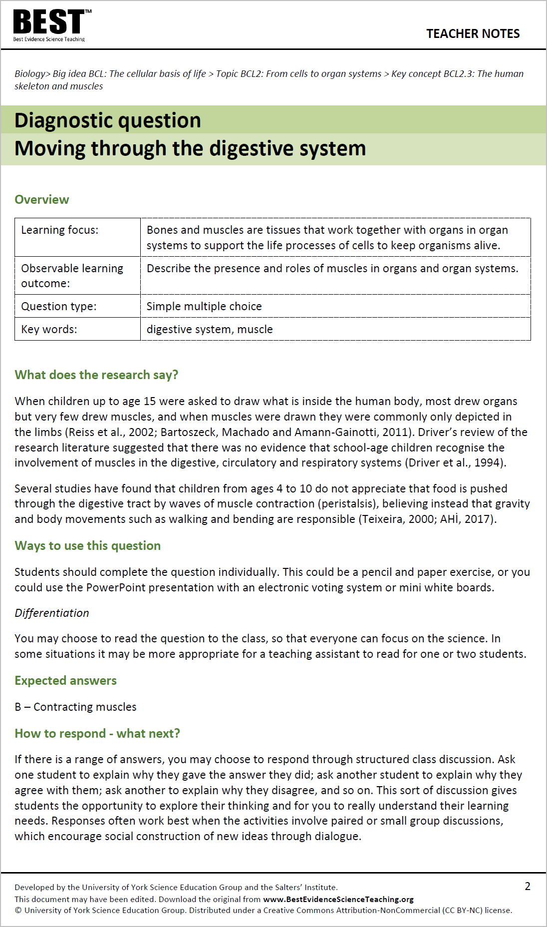
Evidence of impact?
We have undertaken case studies in secondary schools using the BEST resources
We have conducted:
lesson observations
teacher interviews
Observational tool derived from the EEF Improving Secondary Science report
Notes:
Researchers from the University of York Science Education Group have been working with teachers across Yorkshire to investigate how they use the Best Evidence Science Teaching resources in their planning and in their lessons.
The researchers conducted lesson observations and semi-structured interviews with the teachers, and developed an observational tool based on the EEF report – looking for evidence of teachers changing their practices in the seven main areas highlighted in that report.

Slide 23
Evidence of impact? – Yes!
Teachers reported that the research summaries embedded in the BEST resources helped improve their planning, particularly how they:
sequence ideas
describe key concepts
select analogies and models
Preconceptions
Build on the ideas that pupils bring to lessons
Self-regulation
Help pupils direct their own learning
Modelling
Use models to support understanding
Memory
Support pupils to retain and retrieve knowledge
Practical work
Use practical work purposefully as part of a learning sequence
Language of science
Develop scientific vocabulary
In lessons, we observed teachers using the BEST resources to develop practices in all seven of the areas identified in the EEF report
Feedback
Use structured feedback to move on pupils’ thinking
Notes:
In the interviews, teachers reported that the research summaries included in the teacher notes of the Best Evidence Science Teaching resources had introduced them to research and finding that they would not otherwise have know about. What they read often prompted them to make a change to a forthcoming lesson, in particular how they planned to sequence ideas, and the language, analogies and models they chose to describe key concepts – often they made changes to avoid setting up or reinforcing misconceptions.
In lessons, the researchers observed teachers using the BEST resources to develop practices in all seven of the areas identified in the EEF report.

Slide 24

Evidence of impact? – Yes!
The research summaries embedded into the BEST resources appear to:
act as bite-size episodes of
self-directed professional development
lead to immediate changes in practice
Further research is needed to investigate whether these changes:
elicit long-term adaptation of pedagogy
impact student outcomes
Atkinson, L., Dunlop, L., Bennett, J., Fairhurst, P. and Moore, A. (2020) Best Evidence Science Teaching: research evidence in action.
School Science Review, 102 (379), 55-63.
Notes:
Every one of the Best Evidence Science Teaching resources is provided with teacher notes that include a section called “What does the research say?”. That section provides a short summary of the underpinning research and useful teaching approaches. It’s usually just a couple of paragraphs, so it’s quick and easy to read – but gives a teacher insight into some research that they might not otherwise have seen.
It seems that this can function as a bitesize episode of self-directed professional development; it’s easily downloaded and quickly read, and gives teachers a new insight that can prompt them to make a small but potentially impactful change in their classroom practice.
A paper describing our findings was published in the December 2020 issue of School Science Review. Free access to the paper is available at:
https://www.ase.org.uk/system/files/SSR_December_2020_055-063_Atkinson.pdf

Slide 25
@BestEvSciTeach
www.BestEvidenceScienceTeaching.org
Notes:
Download all resources for FREE from: www.BestEvidenceScienceTeaching.org
Follow @BestEvSciTeach on Twitter for updates.

